Slide 1


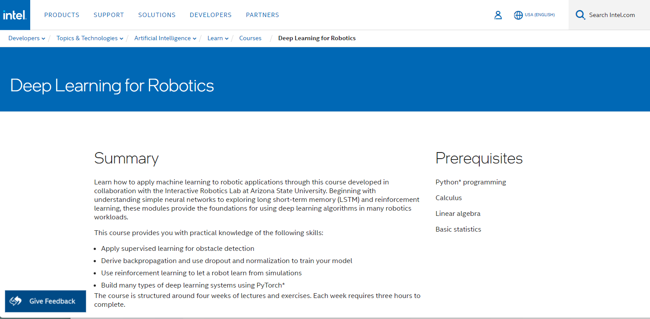
CSC485B Machine Learning for Robotics
SUNY Plattsburgh
Dr. Ned Lecky
Class 14- Datasets and Starting IDLR

Slide 2
Reminder/Aside: Dataset Sources
If you’re still hunting for data!
https://en.wikipedia.org/wiki/List_of_datasets_for_machine-learning_research
https://www.mygreatlearning.com/blog/sources-for-analytics-and-machine-learning-datasets/
For HW3, make your own data or hunt through these cool sources for something that interests you
Then play with our regression, classification, and/or clustering tools!

Slide 3
Next: Intel’s Deep Learning for Robotics
We will work through Intel’s Deep Learning for Robotics Course (IDLR)
Should take approximately 4 weeks
https://www.intel.com/content/www/us/en/developer/learn/course-deep-learning-robotics.html
Rough Format
Each “week” will use 2 classes
One: Lecture on their material
Develop understanding of their problem, solution, and results
Two: Live code execution and experiments in class
Homework: Opportunity for you to get their code to work for you and to make modifications
Moving up from scikit-learn: PyTorch 2.0!

Slide 4
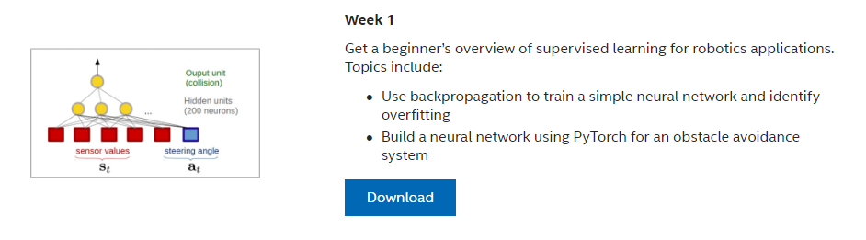
IDLR Week 1

Slide 5
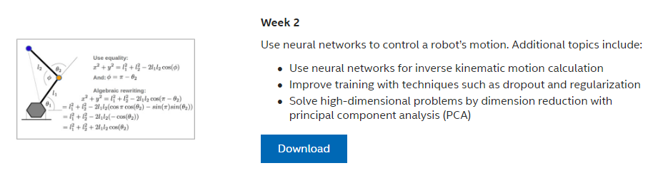
IDLR Week 2

Slide 6
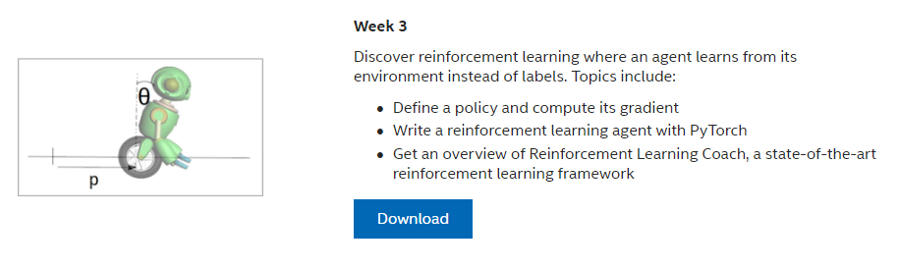
IDLR Week 3

Slide 7
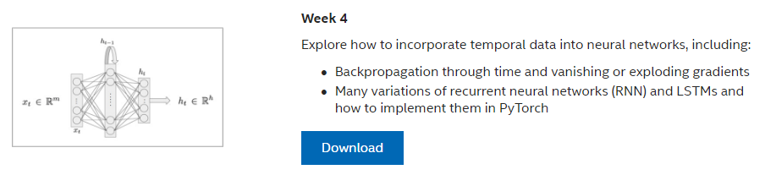
IDLR Week 4

